Slide 1
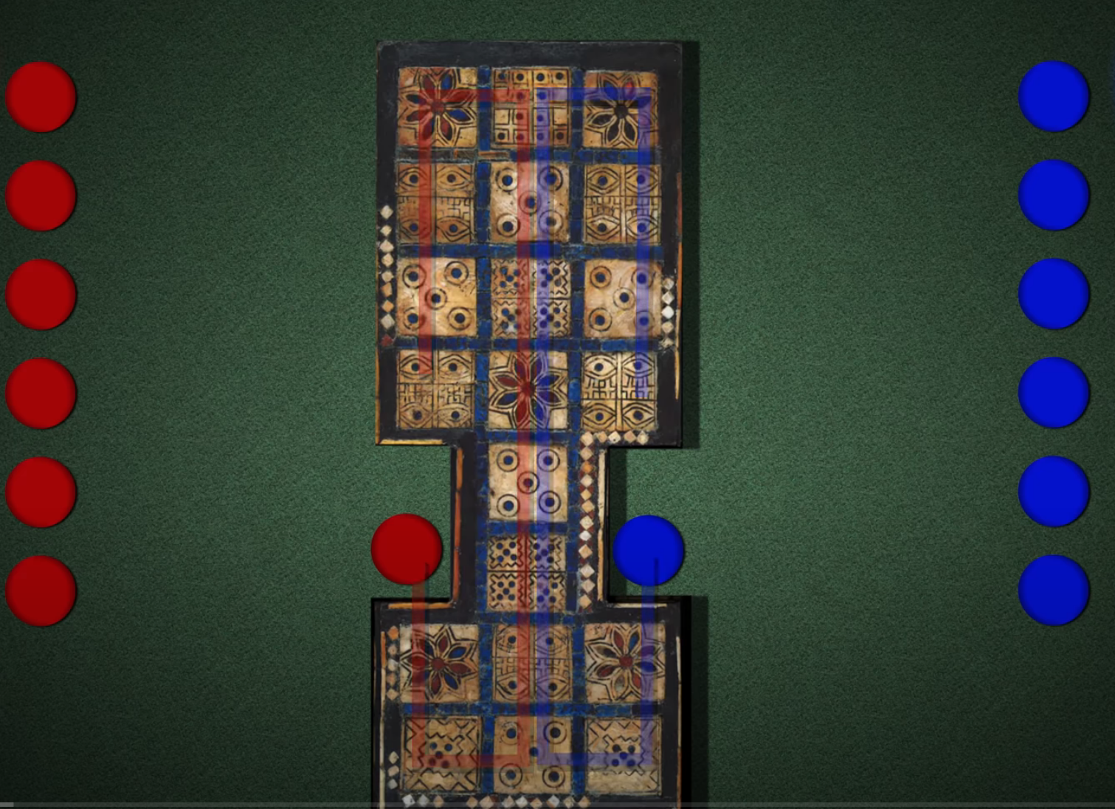
③
③
④
①
①
②
②
③
③

Slide 2
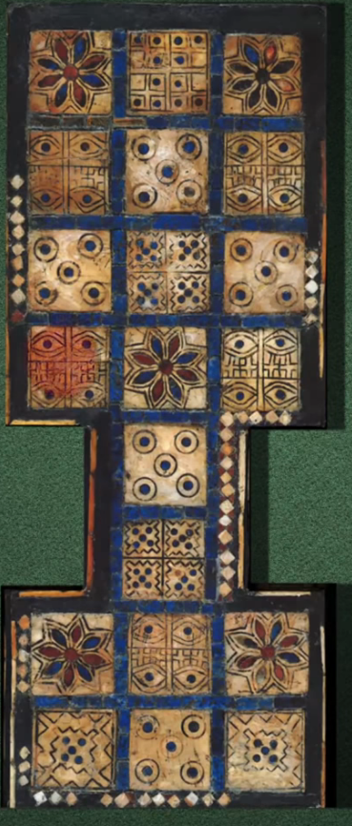
2
1
4
2
0
0
4
1
3
5
5
3

Slide 3
1
1
2
2
0
0
3
4
3
4

Slide 4
0
1
1
0
2
2
3
3

Slide 5
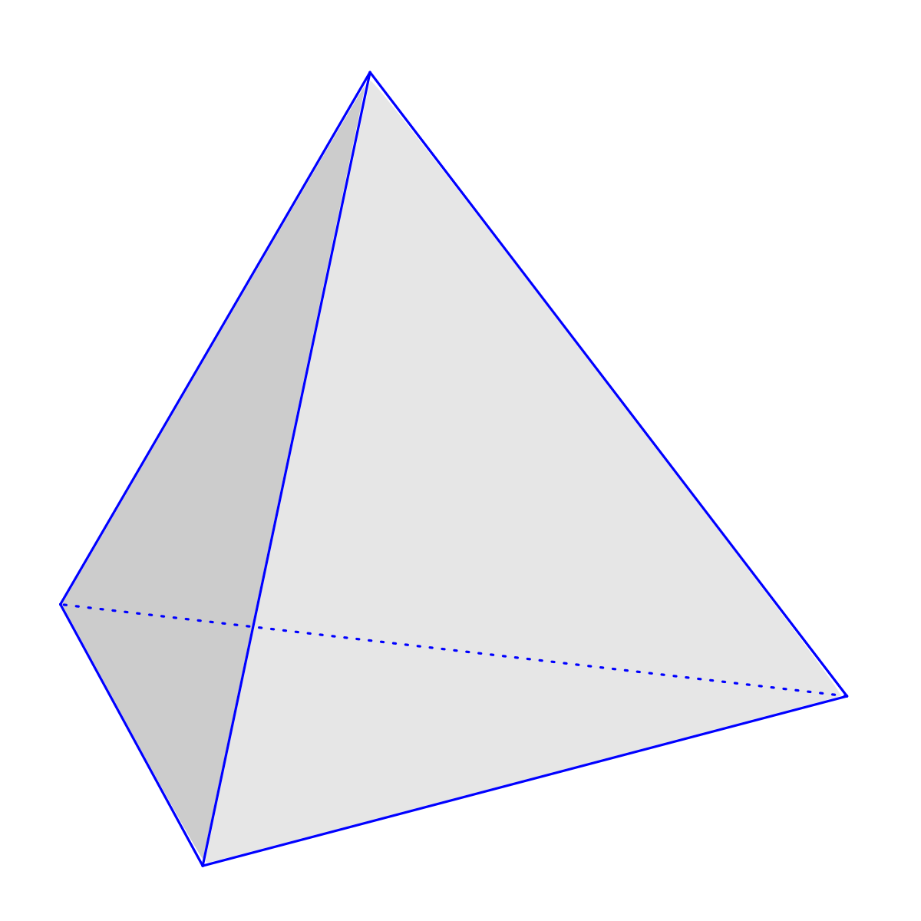
This Photo by Unknown Author is licensed under CC BY-SA

Slide 6
L0 Rosetta | M0 | R0 Rosetta
L1 | M1 | R1
L2 | M2 | R2
L3 | M3 | R3
L4 Start | M4 Peace Rosetta | R4 Start
L5 End | M5 | R5 End
L6 Rosetta | M6 | R6 Rosetta
L7 | M7 | R7

